Slide 1


Vamshi Teja Vallala
August 30, 2023

Slide 2

Outline
Executive Summary
Introduction
Methodology
Results
Conclusion
Appendix

Slide 3
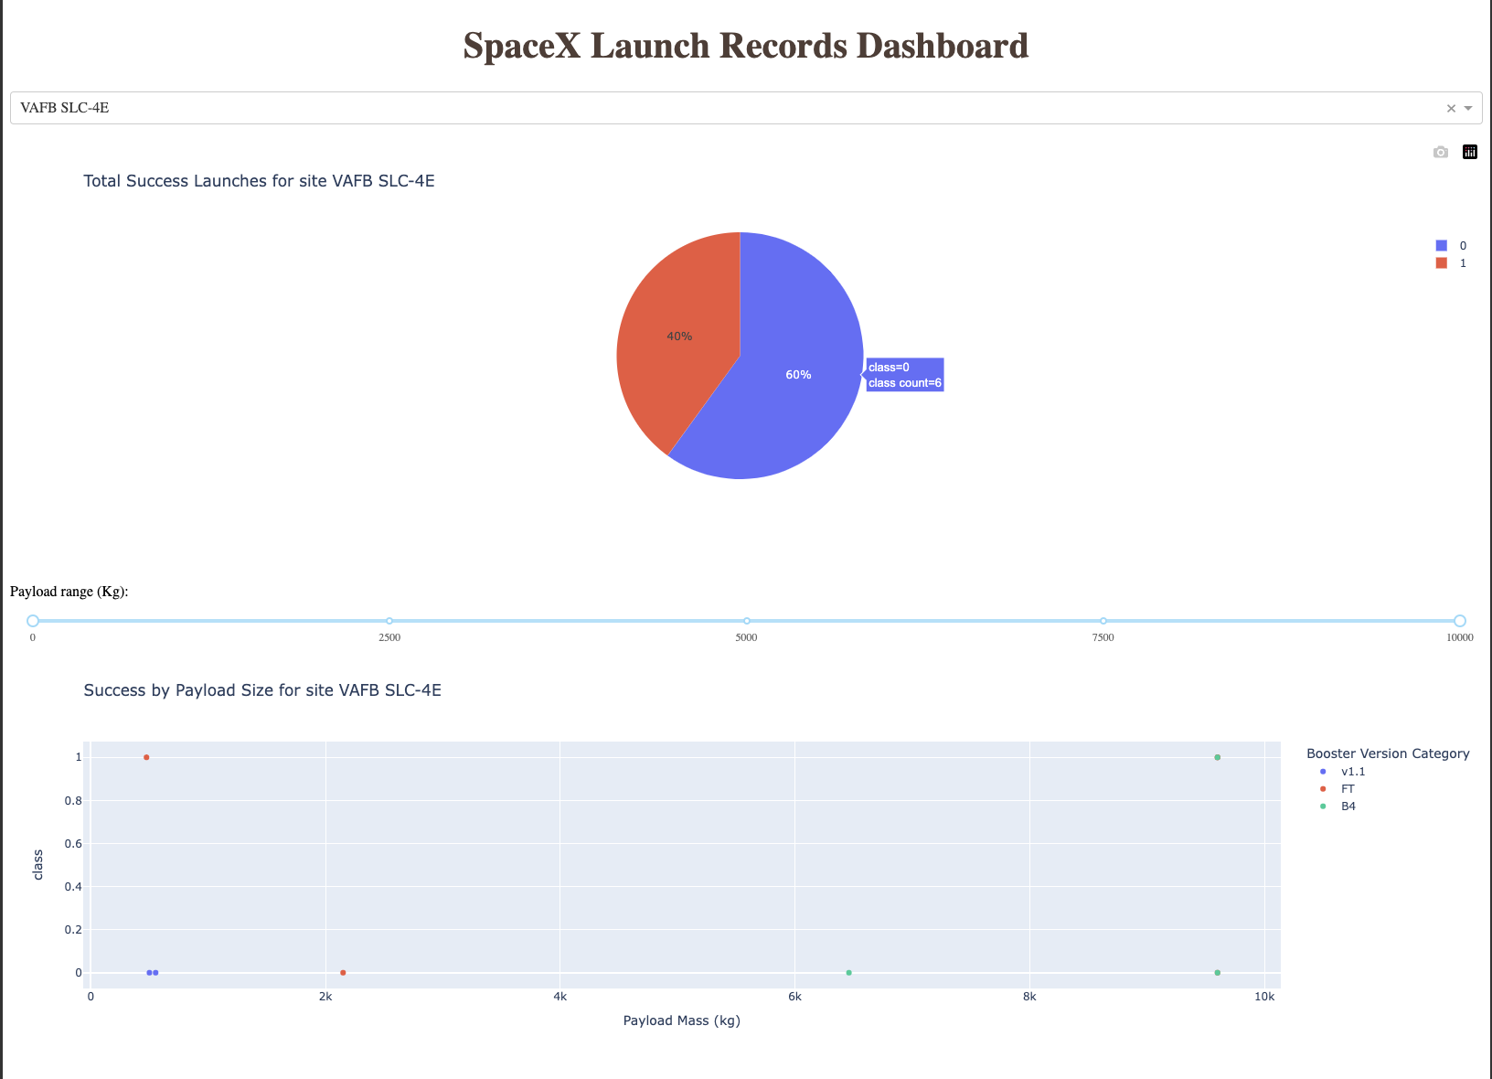
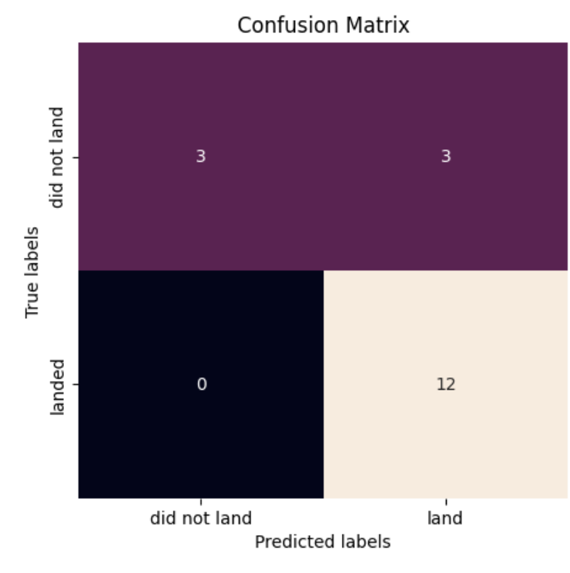
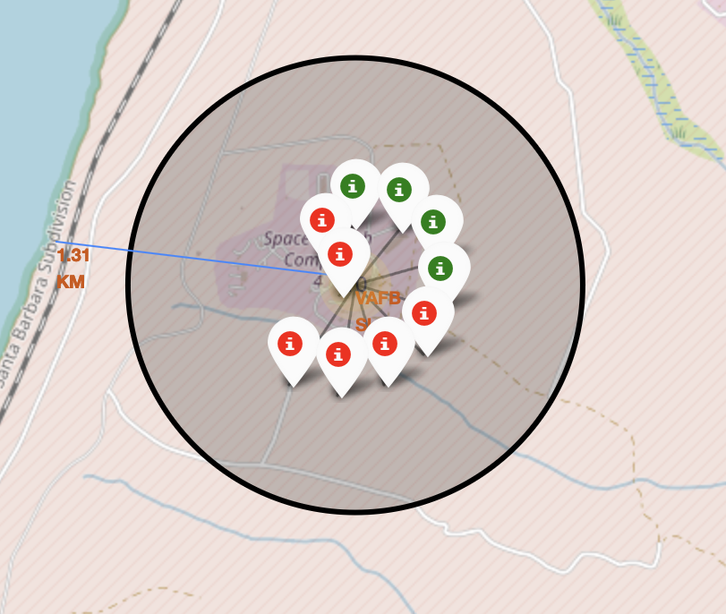
EXECUTIVE SUMMARY
This Project Consists of the Following Methodologies:
Data Collection
Data Wrangling
Data Analysis
Data Visualization
Predictive Analysis
Outcomes of this Project are:
Exploratory Data Analysis Results
Interactive Dashboards
Predictive Classification and Regression Models
Geo Spatial Analysis

Slide 4
INTRODUCTION
Embark on an extraordinary data-driven odyssey exploring the frontier of commercial space exploration. This comprehensive data science project seamlessly navigates through the intricacies of data collection, meticulous wrangling, insightful exploratory analysis, predictive modeling, and the captivating realm of geo-spatial analysis. Our ultimate mission? To unravel the intriguing puzzle of whether SpaceX will opt to reuse its first stage in its rocket launches.
With each data point meticulously gathered and refined, we embark on an intellectual expedition to predict the pivotal decision of first stage reusability using advanced machine learning techniques. This venture is more than data; it's an innovation symphony where human intellect and technology harmonize. In this journey, every line of code and every insightful revelation propels us closer to unlocking the cosmos of SpaceX's reusability strategy.

Slide 5

Section 1

Slide 6
Methodology
Data Collection
Making GET requests to the SpaceX REST API
Web Scraping
Data Wrangling
Using the .fillna() method to remove NaN values
Using the .value_counts() method to determine the following:
Number of launches on each site
Number and occurrence of each orbit
Number and occurrence of mission outcome per orbit type
Creating a landing outcome label that shows the following:
0 when the booster did not land successfully
1 when the booster did land successfully
Exploratory Data Analysis
Using SQL queries to manipulate and evaluate the SpaceX dataset
Using Pandas and Matplotlib to visualize relationships between variables, and determine patterns
4. Interactive Visual Analytics
Geospatial analytics using Folium
Creating an interactive dashboard using Plotly Dash
5. Data Modelling and Evaluation
Using Scikit-Learn to:
Pre-process (standardize) the data
Split the data into training and testing data using train_test_split
Train different classification models
Find hyperparameters using GridSearchCV
Plotting confusion matrices for each classification model
Assessing the accuracy of each classification model

Slide 7
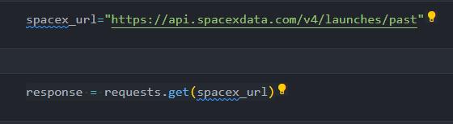
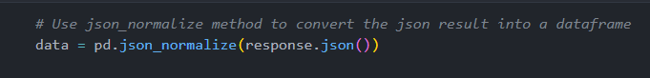
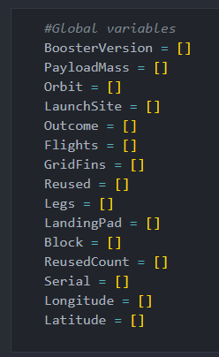
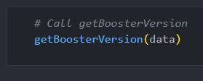
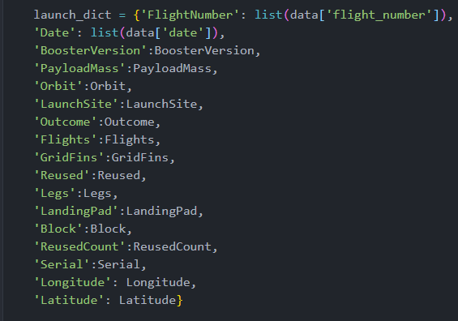
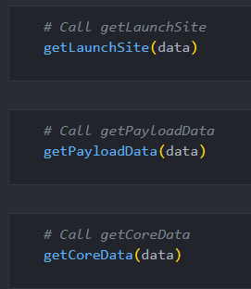
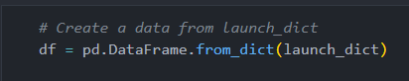
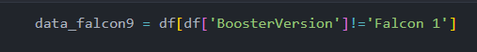
DATA COLLECTION – SPACE X REST API
Using the SpaceX API to retrieve data about launches, including information about the rocket used, payload delivered, launch specifications, landing specifications, and landing outcome.
Make a GET response to the SpaceX REST API
Convert the response to a .json file then to a Pandas DataFrame
Use custom logic to clean the data
Define lists for data to be stored in
Call custom functions to retrieve data and fill the lists
Use these lists as values in a dictionary and construct the dataset
Create a Pandas DataFrame from the constructed dictionary dataset
Filter the DataFrame to only include Falcon 9 launches
Reset the FlightNumber column
Replace missing values of PayloadMass with the mean PayloadMass value
Github Link

Slide 8
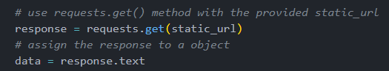
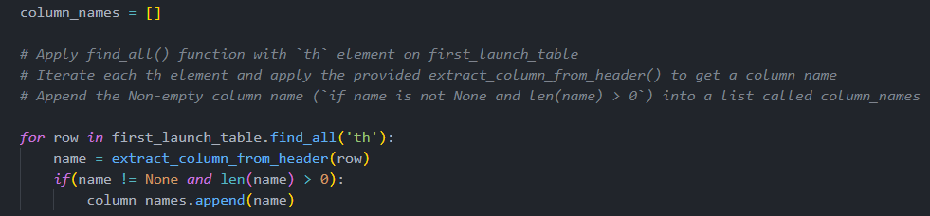
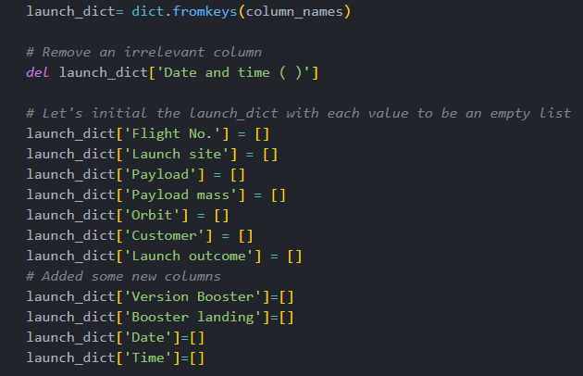
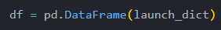
Data Collection - Scraping
We collect data from a Wikipedia page that lists all Falcon 9 missions.
We request HTML object from a URL and save it in a response.
Create a Beautiful Soup Object and then collect all column names found in the HTML Page.
Use the column names as keys in a dictionary
Use custom functions and logic to parse all launch tables to fill the dictionary values.
Convert the dictionary to a Pandas DataFrame ready for export

Slide 9
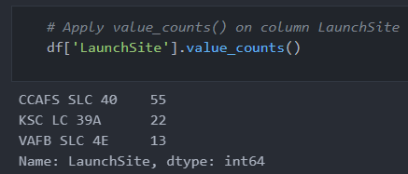
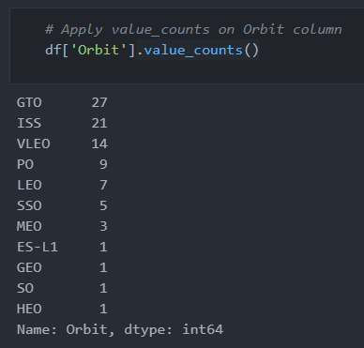

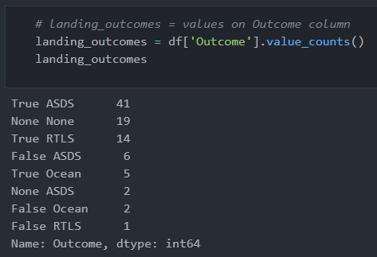
Data Wrangling - GITHUB
Context:
The SpaceX dataset contains several Space X launch facilities, and each location is in the LaunchSite column.
Each launch aims to a dedicated orbit, and some of the common orbit types are shown in the figure below. The orbit type is in the Orbit column.
Initial Data Exploration:
Using the .value_counts() method to determine the following:
Number of launches on each site
Number and occurrence of each orbit
Number and occurrence of landing outcome per orbit type

Slide 10
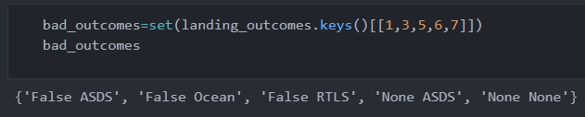
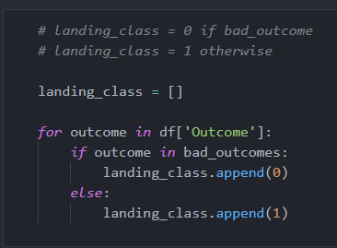
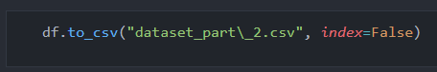
Data Wrangling - GITHUB
Data Wrangling:
To determine whether a booster will successfully land, it is best to have a binary column, i.e., where the value is 1 or 0, representing the success of the landing.
This is done by:
Defining a set of unsuccessful (bad) outcomes, bad_outcome
Creating a list, landing_class, where the element is 0 if the corresponding row in Outcome is in the set bad_outcome, otherwise, it’s 1.
Create a Class column that contains the values from the list landing_class
Export the DataFrame as a .csv file.

Slide 11
EDA with Data Visualization - GITHUB
SCATTER PLOTS
SCATTER PLOTS ARE USED TO OBSERVE CORRELATIONS. WE USED IT FOR FLIGHT NUMBER VS LAUNCH SITE, PAYLOAD VS ORBIT TYPE FOR EXAMPLE.
LINE CHARTS
LINE CHARTS ARE USED TO COMPARE NUMERICAL VALUES, IN OUR CASE, WE USED IT FOR SUCCESS RATE VS YEAR (FOR YEARLY TRENDS)
BAR CHARTS
BAR CHARTS ARE USED TO COMPARE CATEGORICAL VALUES AND, IN OUR CASE, THE SUCCESS RATE VS ORBIT TYPE

Slide 12
EDA with SQL - GITHUB
SQL QUERIES PERFORMED TO GATHER DATA ARE:
Display the names of the unique launch sites in the space mission
Display 5 records where launch sites begin with the string 'CCA’
Display the total payload mass carried by boosters launched by NASA (CRS)
Display average payload mass carried by booster version F9 v1.1
List the date when the first succesful landing outcome in ground pad was acheived.
List the names of the boosters which have success in drone ship and have payload mass greater than 4000 but less than 6000
List the total number of successful and failure mission outcomes
List the names of the booster_versions which have carried the maximum payload mass. Use a subquery
List the records which will display the month names, failure landing_outcomes in drone ship ,booster versions, launch_site for the months in year 2015.
Rank the count of landing outcomes (such as Failure (drone ship) or Success (ground pad)) between the date 2010-06-04 and 2017-03-20, in descending order.

Slide 13

Build an Interactive Map with Folium - GITHUB
The following steps were taken to visualize the launch data on an interactive map:
Mark all launch sites on a map
Initialise the map using a Folium Map object
Add a folium.Circle and folium.Marker for each launch site on the launch map
Mark the success/failed launches for each site on a map
As many launches have the same coordinates, it makes sense to cluster them together.
Before clustering them, assign a marker colour of successful (class = 1) as green, and failed (class = 0) as red.
To put the launches into clusters, for each launch, add a folium.Marker to the MarkerCluster() object.
Create an icon as a text label, assigning the icon_color as the marker_colour determined previously.
Calculate the distances between a launch site to its proximities
To explore the proximities of launch sites, calculations of distances between points can be made using the Lat and Long values.
After marking a point using the Lat and Long values, create a folium.Marker object to show the distance.
To display the distance line between two points, draw a folium.PolyLine and add this to the map.

Slide 14
Build a Dashboard with Plotly Dash - GITHUB
The following plots were added to a Plotly Dash dashboard to have an interactive visualisation of the data:
Pie chart (px.pie()) showing the total successful launches per site
This makes it clear to see which sites are most successful
The chart could also be filtered (using a dcc.Dropdown() object) to see the success/failure ratio for an individual site
Scatter graph (px.scatter()) to show the correlation between outcome (success or not) and payload mass (kg)
This could be filtered (using a RangeSlider() object) by ranges of payload masses
It could also be filtered by booster version

Slide 15
Predictive Analysis (Classification) - GITHUB
MODEL DEVELOPMENT
After Dataset was cleaned and transformed with preprocessing, data was then split into train and test sets with train_test_split().
Models were built using Linear Reg, Logistic Reg, SVM, KNN, and Decision Trees.
To choose the parameters, the models are then run through GridSearchCV.
MODEL EVALUATION
For model evaluation, several metrics were chosen. Accuracy, F1 score, MSE, MAE were the main metrics.
The model was run through GridSearchCV for choosing the best hyperparameters.
A validation set is used to choose the best parameters for a model with the highest accuracy and minimal loss.
FINAL MODEL SELECTION
We plot the confusion matrix and and examine the performance.
We choose the best accuracy model.

Slide 16

Section 2

Slide 17
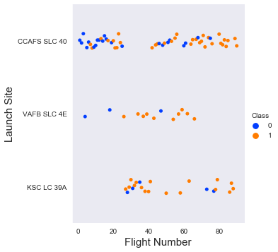
Flight Number vs. Launch Site
We can see that most early flights from the launch site CCAFS SLC 40 were unsuccessful.
As the flight number increased, as more and more flights were launched, the success rate increased as well.
VAFB SLC 4E was scarcely used compared to the others.

Slide 18
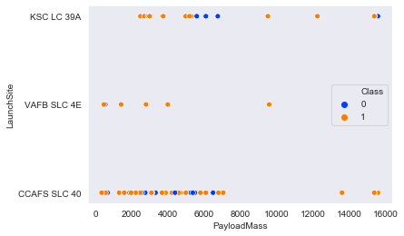
Payload vs. Launch Site
I see no correlation between these launch sites and payload mass.
Payload mass > 7000 has very few failures.

Slide 19
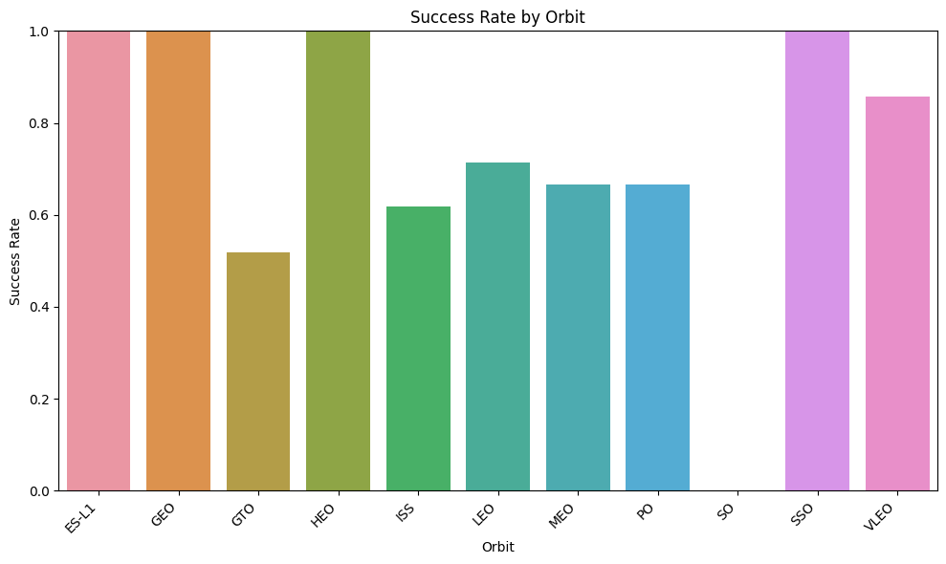
Success Rate vs. Orbit Type
We can draw the conclusion that success rate for all orbits except SO was over 50%.
SO only had one launch and it was a failure.
The success rate for Orbits ES-L1, GEO, HEO, and SSO were 100%.

Slide 20
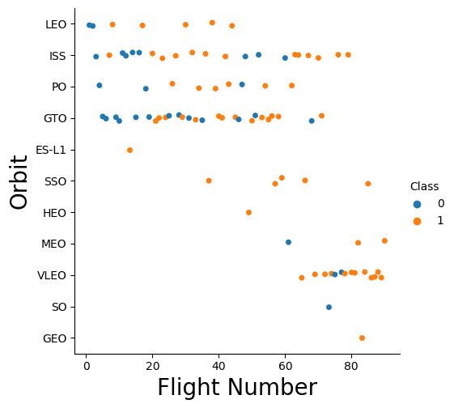
Flight Number vs. Orbit Type
Most initial launches were done into orbits LEO, ISS, PO, GTO.
Possibly because these are low risk orbits. As we can see, most flight numbers < 40 were failures.
These 4 orbits were tested until 60 flights until success was more often, then they shifted to other orbits like SSO, HEO, MEO, VLEO etc.

Slide 21
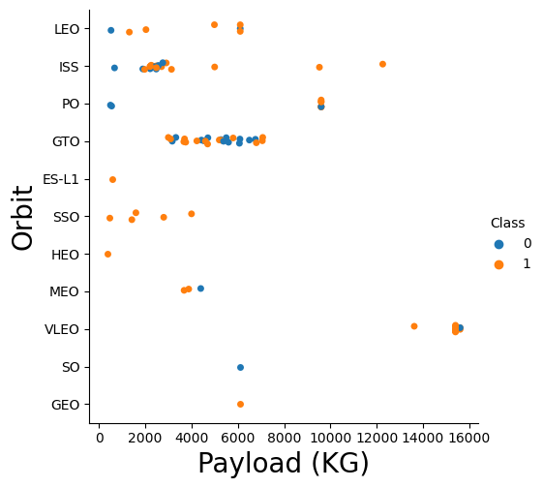
Payload vs. Orbit Type
Initial, lower payloads were launched into orbits SSO, HEO, ISS, LEO. These orbits were tested for success.
From payload > 3000, Orbit GTO was extensively used, and its success rate is as much as its failure.
From payload > 8000, GTO was relieved and other orbits were proving greater success.

Slide 22
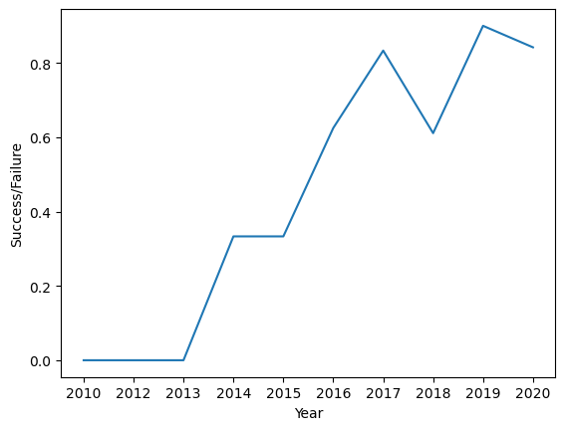
Launch Success Yearly Trend
The yearly trend for success is almost an upward trend.
Except for the drop in 2018, Space X has seen tremendous upward success in their launches.

Slide 23
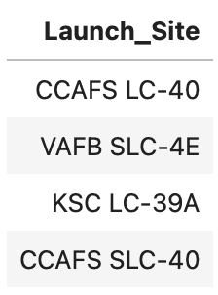
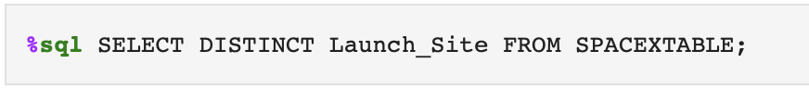
All Launch Site Names
The query SELECT DISTINCT will show unique names in Launch_Site column in the SPACEXTABLE;

Slide 24
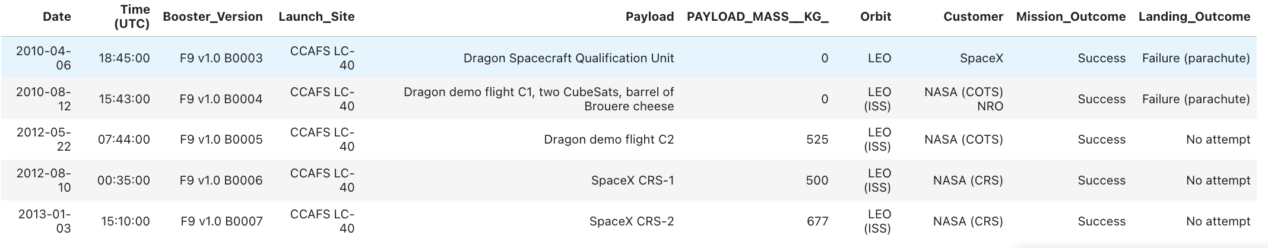
Launch Site Names Begin with 'CCA'
The query shows all rows of the table SPACEXTABLE where Launch_Site column contains a string expression ‘CCA’

Slide 25
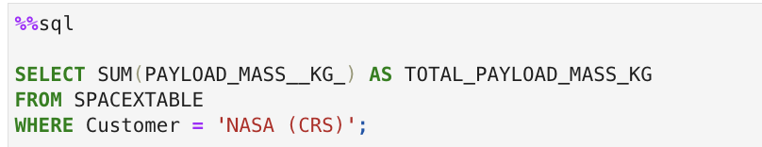
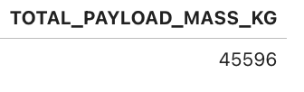
Total Payload Mass
The query sums the whole payload mass and presents it in a column name “TOTAL_PAYLOAD_MASS_KG” for the customer NASA(CRS).
This helps us identify the payload for a specific customer of interest.

Slide 26
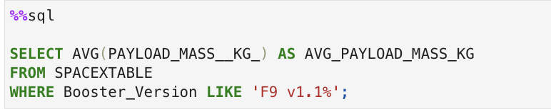
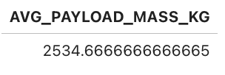
Average Payload Mass by F9 v1.1
The query now averages the payload mass for a specific booster version F9 v1.1.

Slide 27

First Successful Ground Landing Date
The query shows the earliest Date (MIN) where the landing outcome column shows success(of any kind).

Slide 28
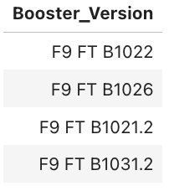
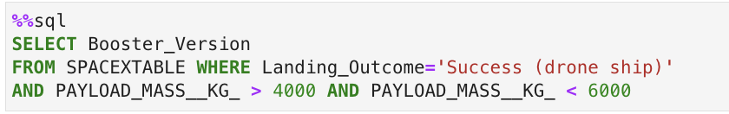
Successful Drone Ship Landing with Payload between 4000 and 6000
The query shows us the Booster Versions that have successful drone ship landing outcome.
It further narrows down for Payload Mass between 4000 and 6000 kgs.

Slide 29
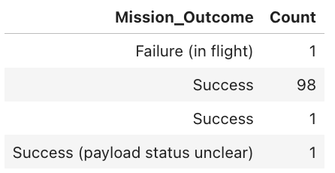
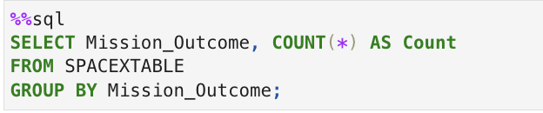
Total Number of Successful and Failure Mission Outcomes
The query here groups the mission outcomes by successes and failures using the COUNT keyword.
In the table, we have different kinds of success hence 3 different groups.

Slide 30
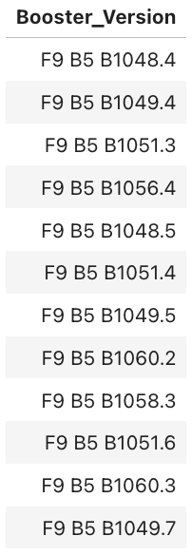
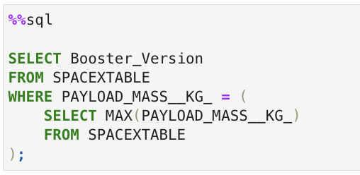
Boosters Carried Maximum Payload
The query here shows us the Booster Version that have carried the maximum Payload.
To calculate the maximum Payload_mass, we use a subquery SELECT MAX().

Slide 31
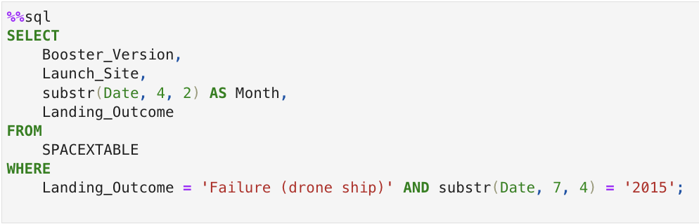
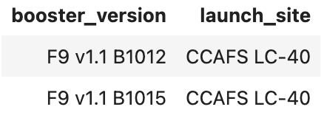
2015 Launch Records
The query lists the failed landing outcomes in drone ship, in the year 2015.

Slide 32
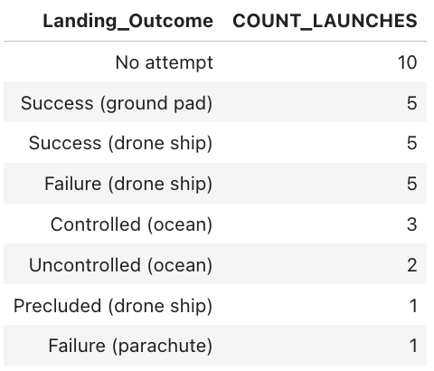
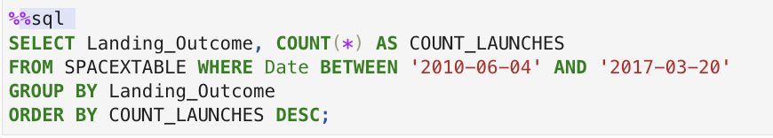
Rank Landing Outcomes Between 2010-06-04 and 2017-03-20
The query sorts (ranks) the Landing Outcome groups (such as Failure (drone ship) or Success (ground pad)) based on the number of counts.
The query narrows the search to be between June 4th, 2010, and March 20th, 2017.

Slide 33

Section 3

Slide 34
<Folium Map Screenshot 1>
Replace <Folium map screenshot 1> title with an appropriate title
Explore the generated folium map and make a proper screenshot to include all launch sites’ location markers on a global map
Explain the important elements and findings on the screenshot

Slide 35
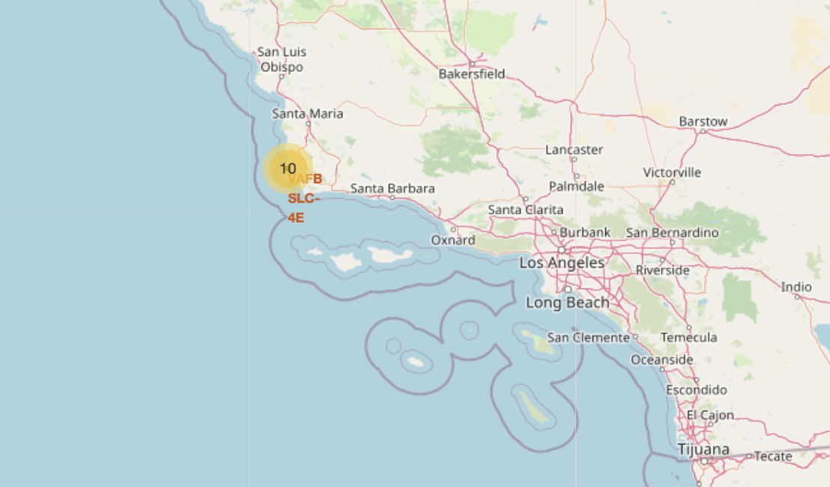

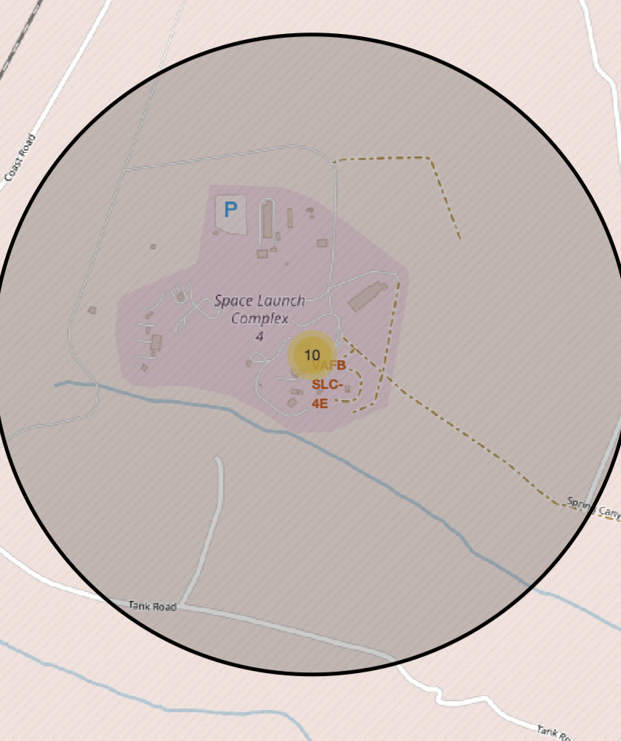
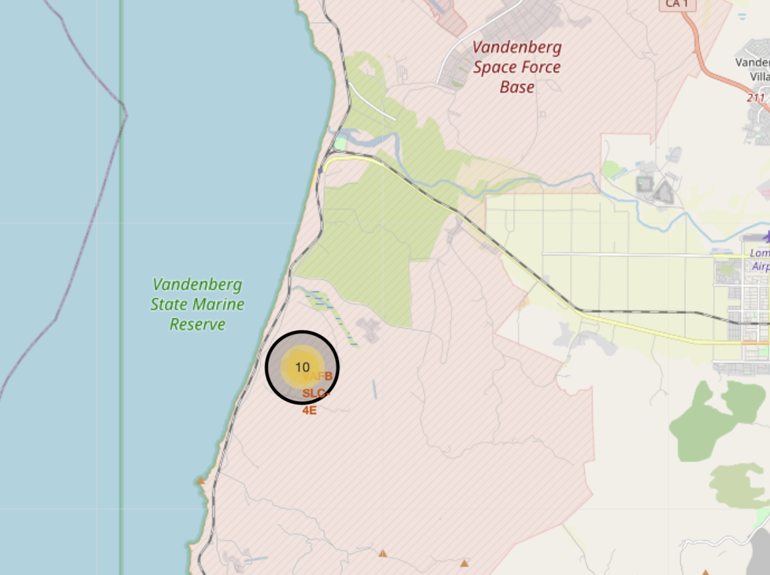
ALL LAUNCH SITES ON A MAP
All SpaceX launch sites are on coasts of the United States of America, specifically Florida and California.

Slide 36





SUCCESS AND FAILURES BY SITES
Launches have been grouped into clusters, and annotated with green icons for successful launches, and red icons for failed launches.
CCAFS SLC-40 and CCAFS LC-40
VAFB SLC-4E
KSC LC-39A

Slide 37
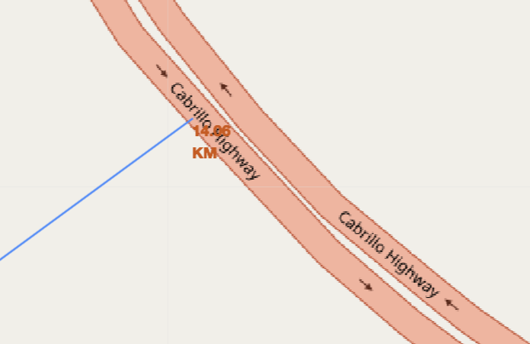
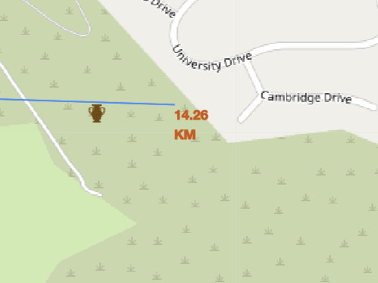
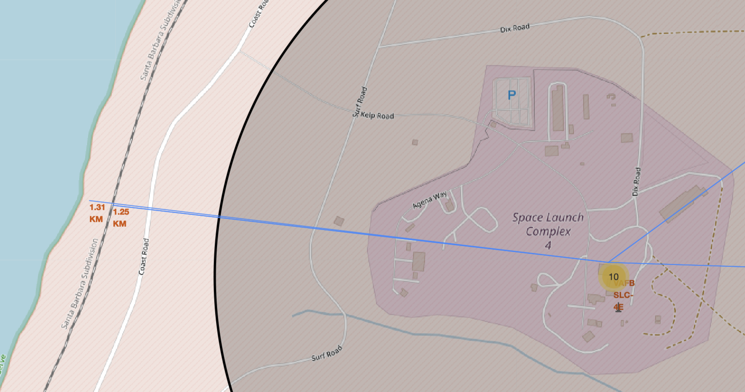
FOLIUM MAP PROXIMITIES
Are launch sites near railways?
YES. The coastline is only 1.31 km due West.
Are launch sites near highways?
YES. The nearest highway is only 14.06 km away.
Are launch sites near to railways?
YES. The nearest railway is only 1.25 km away.
Do launch sites keep certain distance away from cities?
YES. The nearest city is 14.26 km away.
Using the VAFB SLC-4E launch site as an example site, we can understand more about the placement of launch sites.

Slide 38

Section 4

Slide 39

PIE CHART FOR ALL LAUNCH SITES
In the pie chart for all launch sites, we can see the KSC LC-39A has the highest success percentage at 41.7%.

Slide 40

PIE CHART FOR LAUNCH SITE WITH HIGHEST SUCCESS
KSC LC-39A is the Launch Site with the highest success rate at 76.9%.

Slide 41



LAUNCH OUTCOME VS PAYLOAD MASS FOR ALL SITES
Plotting the launch outcome vs. payload for all sites shows a gap around 4000 kg, so it makes sense to split the data into 2 ranges:
0 – 4000 kg (low payloads)
4000 – 10000 kg (massive payloads)
From these 2 plots, it can be shown that the success for massive payloads is lower than that for low payloads.
It is also worth noting that some booster types (v1.0 and B5) have not been launched with massive payloads.

Slide 42

Section 5

Slide 43



Classification Accuracy
Plotting the Accuracy Score and Best Score for each classification algorithm produces the following result:
ALL models have the same classification accuracy.
The Accuracy Score is 83.33%
The Best Score is 89.12%

Slide 44

Confusion Matrix
As shown previously, all models classified with the same accuracy at 83.33%.
This is explained by the 3 false negatives we have. The other categories are all correctly classified.
The other 15 results are correctly classified (3 did not land, 12 did land, 3 were false positives).

Slide 45






CONCLUSIONS
As the number of flights increases, the rate of success at a launch site increases, with most early flights being unsuccessful. i.e. with more experience, the success rate increases.
Between 2010 and 2013, all landings were unsuccessful (as the success rate is 0).
After 2013, the success rate generally increased, despite small dips in 2018 and 2020.
Orbit types ES-L1, GEO, HEO, and SSO, have the highest (100%) success rate.
The 100% success rate of GEO, HEO, and ES-L1 orbits can be explained by only having 1 flight into the respective orbits.
The orbit types PO, ISS, and LEO, have more success with heavy payloads:
VLEO (Very Low Earth Orbit) launches are associated with heavier payloads, which makes intuitive sense.
The launch site KSC LC-39 A had the most successful launches, with 41.7% of the total successful launches, and also the highest rate of successful launches, with a 76.9% success rate.
As payload gets over 4000kgs, the success increases as well for all Booster Versions.
All the models performed the same in accuracy with 83.33%

Slide 46


Appendix
In the Data Collection – REST API, there are some customs logics used in Data Collection and Web Scraping which are worth noting:

Slide 47


APPENDIX
In the Data Collection – Web Scraping, there are some customs logics used in Data Collection and Web Scraping which are worth noting:

Slide 48


